Slide 1
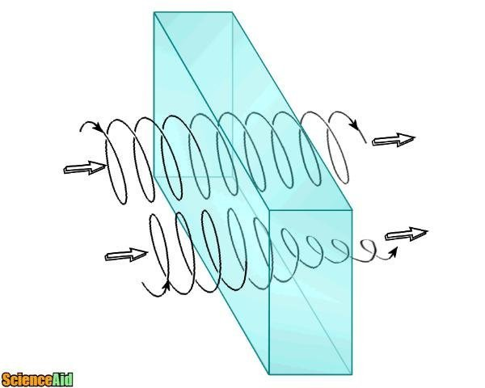
CHM 5681
Circular Dichroism
Source
Detector
Sample

Slide 2
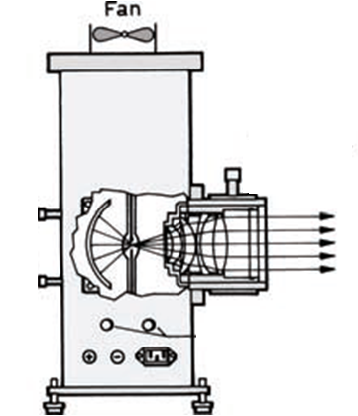
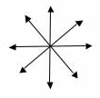
UV-Vis Spectroscopy
Detector
Sample
End View
Unpolarized Light

Slide 3
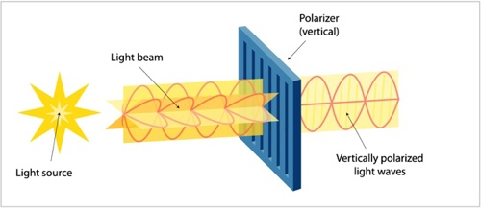
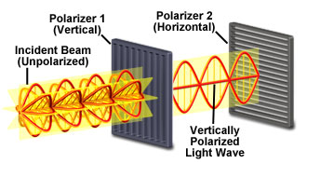
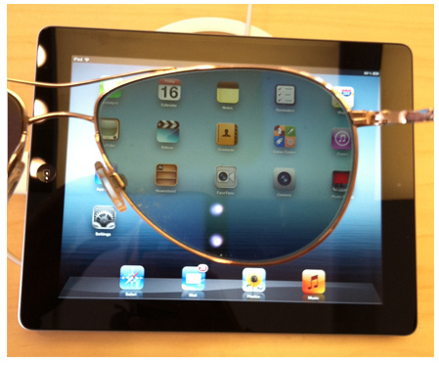
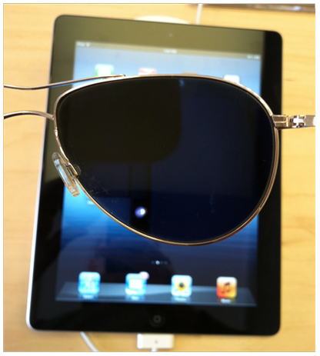
Polarizers

Slide 4
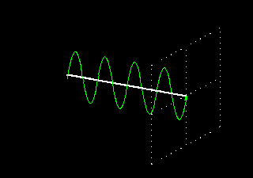
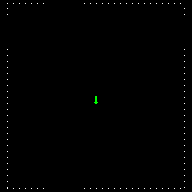
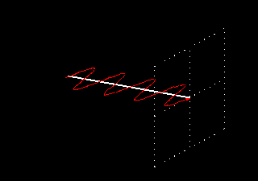
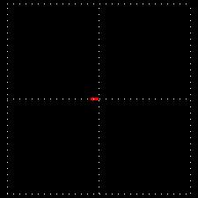
Polarization of Light
Vertically Polarized
Side View
End View
Horizontally Polarized
http://cddemo.szialab.org/

Slide 5

Light + Atoms
https://www.reddit.com/user/Tnemirepxe

Slide 6
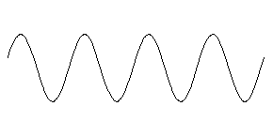
Light + Molecules
Source
Strong Absorption
Weak Absorption

Slide 7
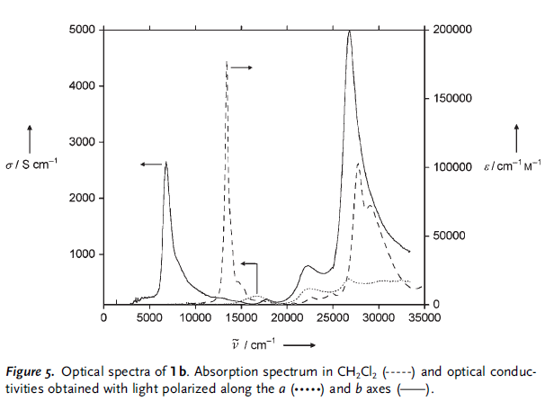
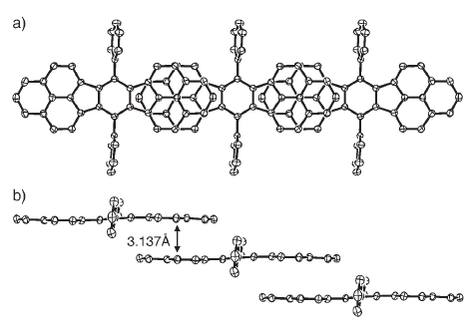
Orientation Dependent Absorption
a axis
b axis
Angew. Chem. Int. Ed. 2005, 44, 6564 –6568

Slide 8
Polarization of Light
Vertically Polarized
Side View
End View
Horizontally Polarized
http://cddemo.szialab.org/

Slide 9
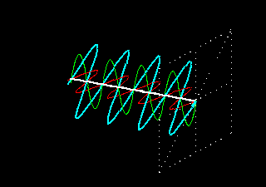
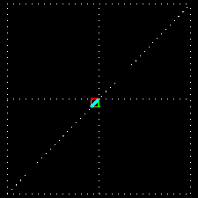
Adding Polarized Light
In phase (peak at the same time) + same amplitude
Vertical + Horizontal = 45° diagonal

Slide 10
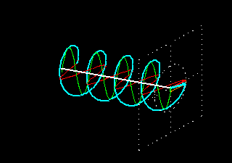
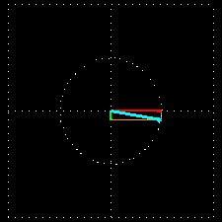
Adding Polarized Light
¼ λ (90°) out of phase + same amplitude
Vertical + Horizontal = Circular
Green peaks when red baselines.
Sum (blue) is always 1.

Slide 11
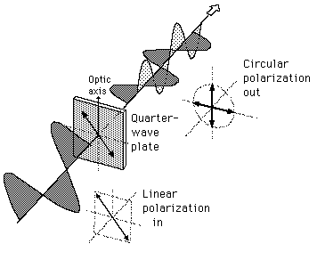
λ/4 Wave Plate Polarizer
λ/4 Wave Plate Polarizer

Slide 12
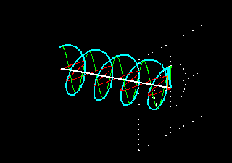
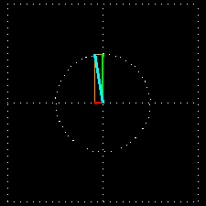
Polarization of Light
left-circularly polarized
Side View
End View
right-circularly polarized

Slide 13
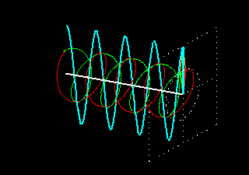
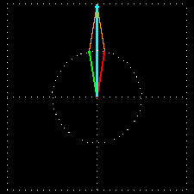
Adding Polarized Light
In phase (peak at the same time) + same amplitude
left circular + right circular = vertical
Green peaks when red peaks.

Slide 14
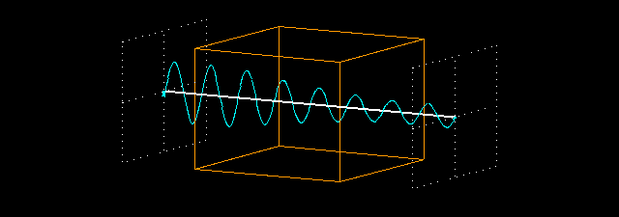
Absorption Spectroscopy
P₀
P
(power in)
(power out)
P
P₀
Absorbance:
A = -log T = log P₀/P

Slide 15
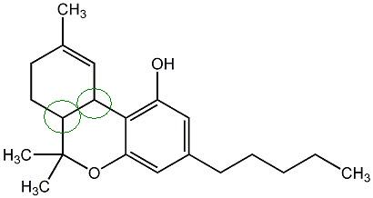
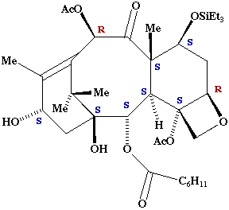
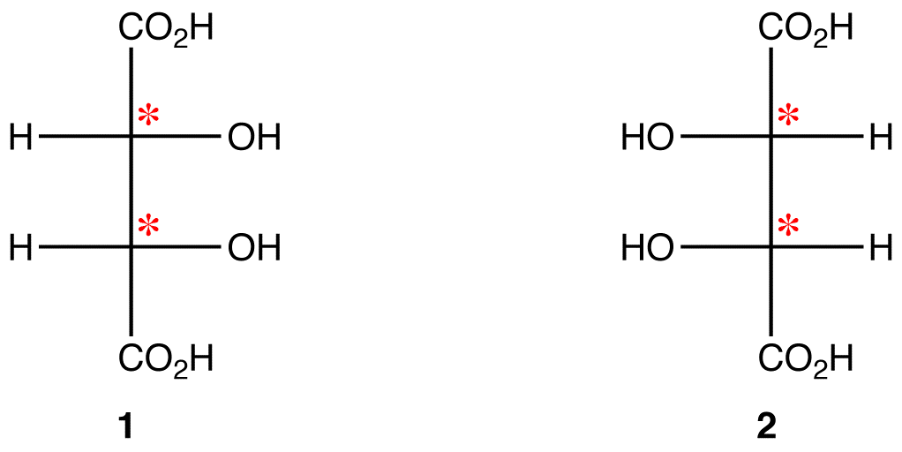
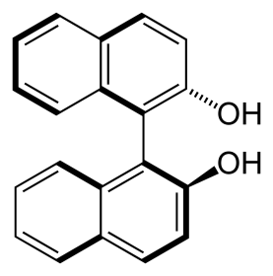
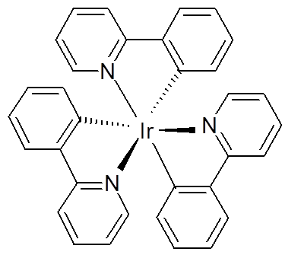
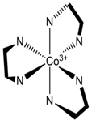
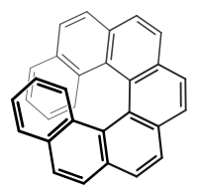
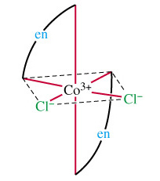
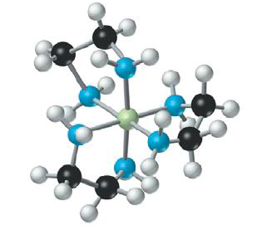
Chiral Molecules/Materials
Molecules are optically active if it contains at least one chiral center.
Many molecules have no chiral centers and yet are optically active.

Slide 16
Optical Activity and Symmetry
Which molecules are expected to be optically active?
Molecules with no improper axis of rotation (S_{n}) are optically active.
Note S₁ = σ and S₂ = i.
Chiral molecules lack an improper axis of rotation (S_{n}), a center of symmetry (i) or a mirror plane (σ)!
Nonaxial (no rotation)
  - C₁, C_{s}, C_{i}
Cyclic (rotational)
  -C_{n}, C_{nv}, C_{nh}, S_{n}
Dihedral (⊥C₂)
  - D_{n}, D_{nd}, D_{nh}
Polyhedral
  - T, T_{h}, T_{d}, O, O_{h}, I, I_{h}
Linear
  - C_{∞v}, D _{∞h}
C₁, C_{n}, and D_{n}
Also T, O, and I

Slide 17
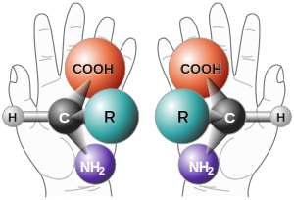
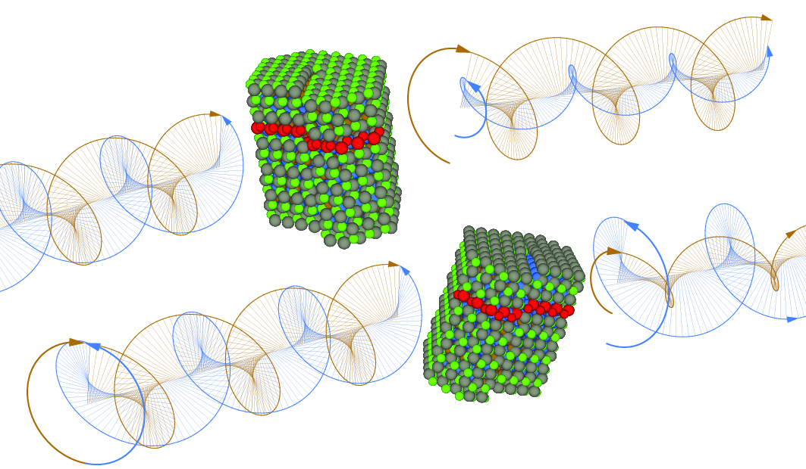
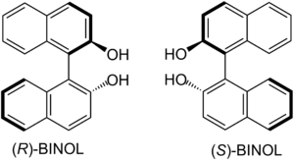
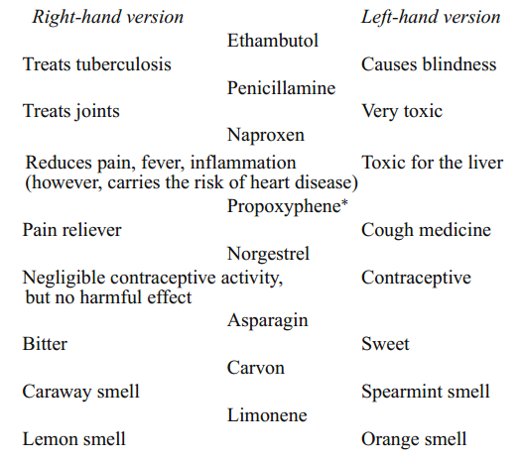
Chiral Molecules/Materials
DNA is right handed
Amino acids are L
Carbohydrates are D
Alpha Helix is right handed
Origin/Evolution of life
Drug delivery/processing
Olfactory receptors

Slide 18
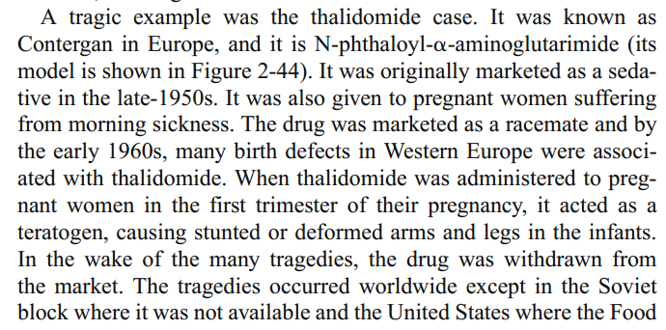
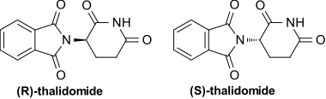
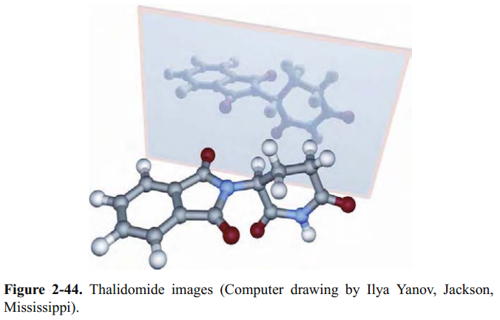
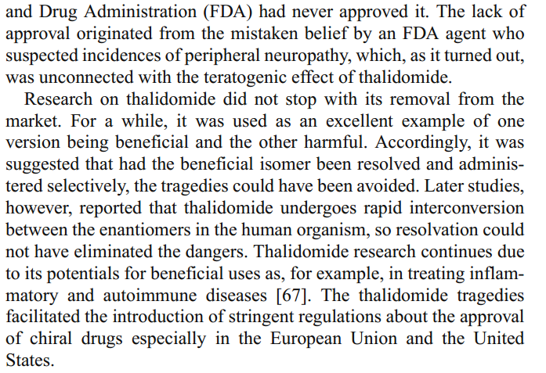
Importance of Chiral Molecules

Slide 19
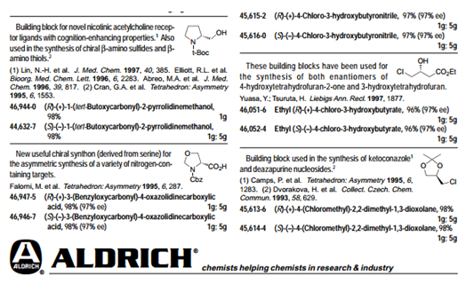
Naming Conventions
R / S, d/l and (+)/(−) are not related.
R / S system- requires no reference molecule (Cahn–Ingold–Prelog priority rules)
d/l system- referenced vs glyceraldehyde.
(+)/(−) system- related to the direction to which it rotates plane polorized light.
(+) –rotates the plane polarized light clockwise (when viewing towards the light source)
(-) –rotates the plane polarized light counterclockwise

Slide 20
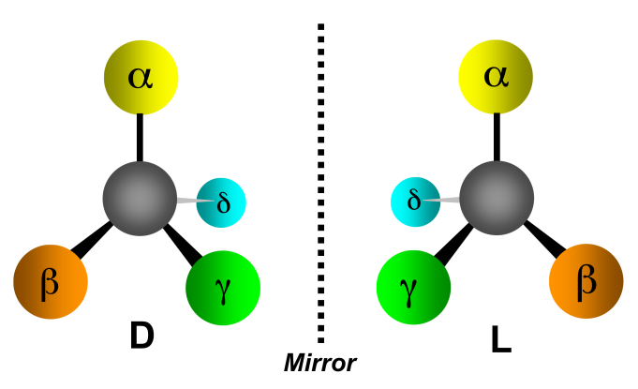
Absorption Spectroscopy
The Beer-Lambert Law:
A = ε c l
ε is the same for D and L
If C are equal:
50:50 D to L
100% D
100% L
Then A is the same.
  A = absorbance (unitless, A = log₁₀ P₀/P)
  ε = molar absorptivity (L mol⁻¹ cm⁻¹)
  l = path length of the sample (cm)
  c = concentration (mol/L or M)
Assuming the light is unpolarized!

Slide 21
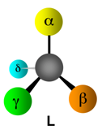
Circular Absorption
Absorbs Less
Larger P
left-circularly polarized
right-circularly polarized
Absorbs more
Smaller P
P₀
P
(power in)
(power out)

Slide 22
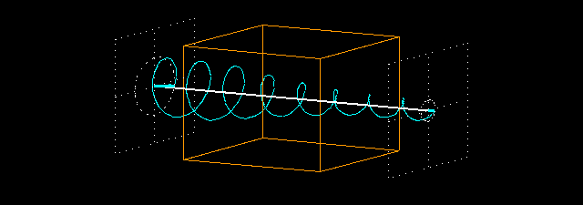
Circular Absorption
P_{(left)}
P_{0(left)}
Absorbance:
A_{(left)} = log P_{0(left)} /P_{(left)}
A_{(right)} = log P_{0(right)}/P_{(right)}
P₀
P
(power in)
(power out)

Slide 23




Circular Dichroism
CD measures the difference between the absorption of left and right handed cirularly-polarized light:
Δε is typically <10 M⁻¹ cm⁻¹
ε is typically > 10,000 cm⁻¹
CD spectra reported in ellipticity (θ) or Δε
θ = 3298 Δε.
ε in L/mol cm (liters mol⁻¹ centimeters⁻¹)
θ in degrees cm²/dmol⁻¹ (degrees centimeters² decimol⁻¹)

Slide 24
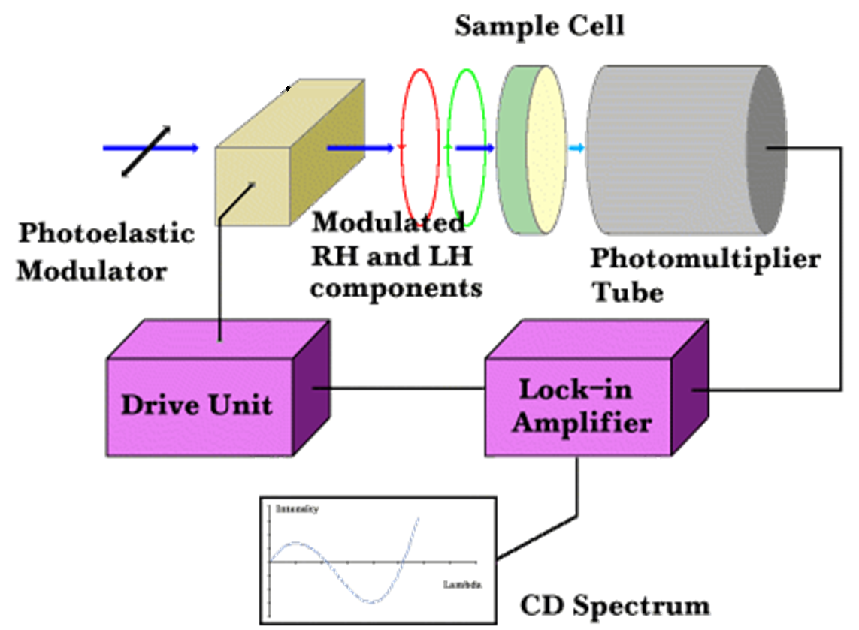
Circular Dichroism
Source
Polarizer
Prism
Process:
1) Unpolarized white light
2) Monochrometer
3) Plane polarizer
4) left-right modulator
5) left (then right) through sample
6) measure P for right (then left) through sample

Slide 25
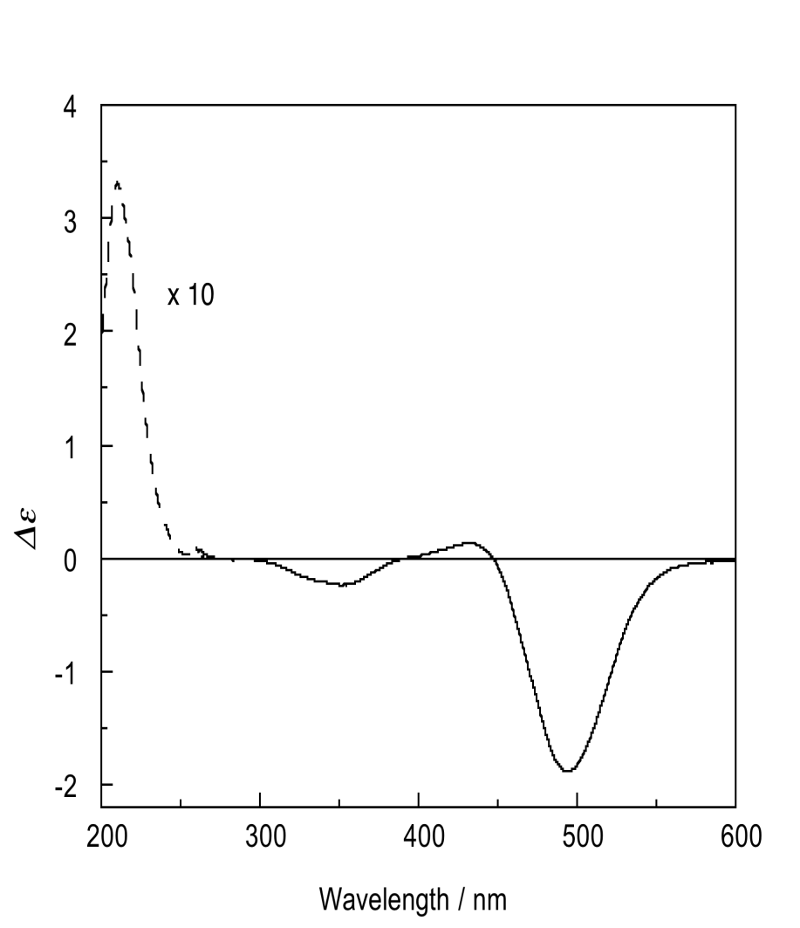
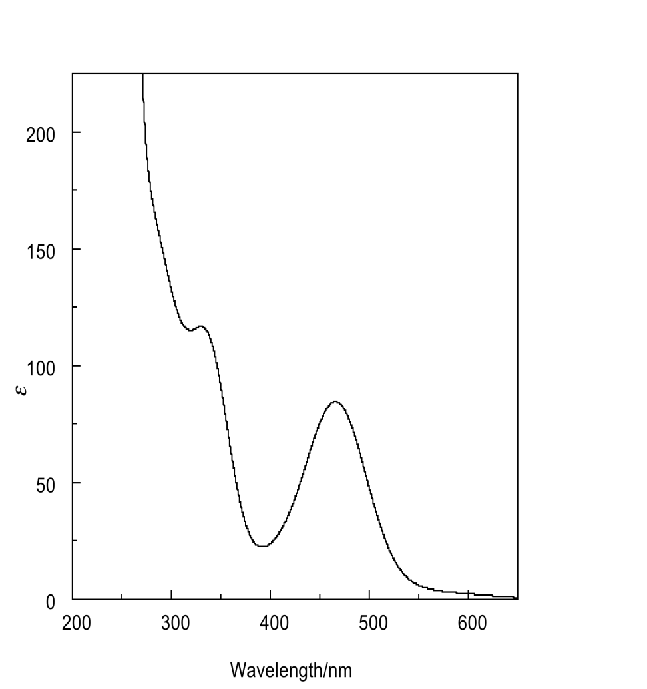
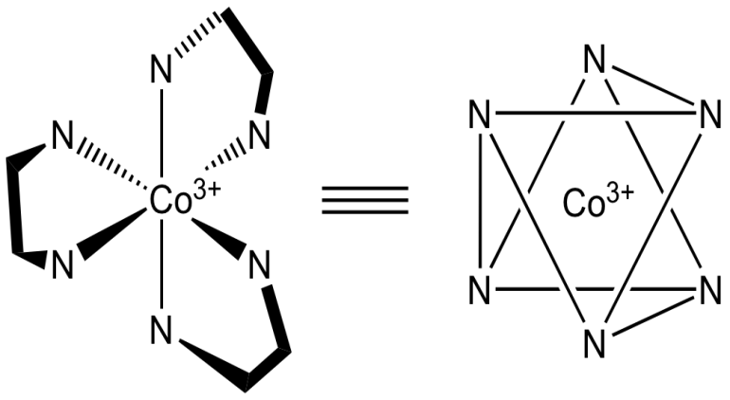
Spectra
Absorption
Circular Dichroism

Slide 26

CD Spectrometer
AVIV 202 CD spectrometer
Institute of Molecular Biophysics
170-875 nm
-10ºC to 110ºC
titrator attachment

Slide 27




Applications
• Determination of secondary structure of proteins
• Investigations of protein-protein interactions
• Investigation of the effect of drug binding
• Protein structure in a membrane
• Stereoselective synthesis
• Dynamic processes
- protein folding
- reaction dynamics
• Non-linear Optics
DNA denaturation
GCN4-p1 coiled–coil

Slide 28



CD Spectrometer
JASCO, J-1500 Circular Dichroism Spectrophotometer
PMT detector (163 – 950 nm)
Optional InGaAs detector (up to 1600 nm)
Automated high-throughput (192 samples)
Liquids to films to solid-states

Slide 29
CD End
Any Questions?

